Slide 1
Climategate: a Battlefield Perspective
Stephen McIntyre
Climate Audit
Toronto Ontario
Heartland Conference
Chicago IL
May 16, 2010

Slide 2
The Backstory of the “Trick”
1998 Briffa and Mann reconstructions,
1999 IPCC Lead Authors’ meeting in Arusha
2001 IPCC AR3
2006 NAS panel
2007 IPCC AR4
2008 FOI requests
2009 Climategate
2010 The Inquiries

Slide 3
Some Caveats
Neither the trick nor the Climategate emails as a whole disprove global warming nor does climate science stand or fall on the emails;
Proxy reconstructions are tangential to the “big” questions of cloud and water cycle feedbacks and overall climate sensitivity;
Neither angriness nor vindictiveness are useful emotions in this debate. There are substantial conduct issues arising out of the Climategate letters, but over-statement and imprecision on both sides are obstacles to resolution.

Slide 4
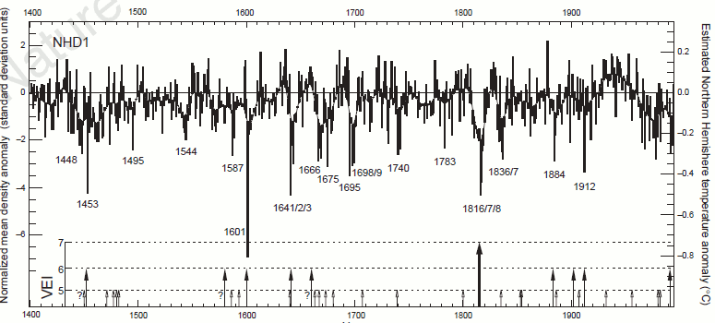
The Briffa Reconstruction
Left – Briffa et al 1998 (Nature 393) Figure 1 showing temperature reconstruction; right – Briffa 1998 (Proc Roy Soc London) Figure 6 (in standard deviation units) showing “divergence problem”

Slide 5
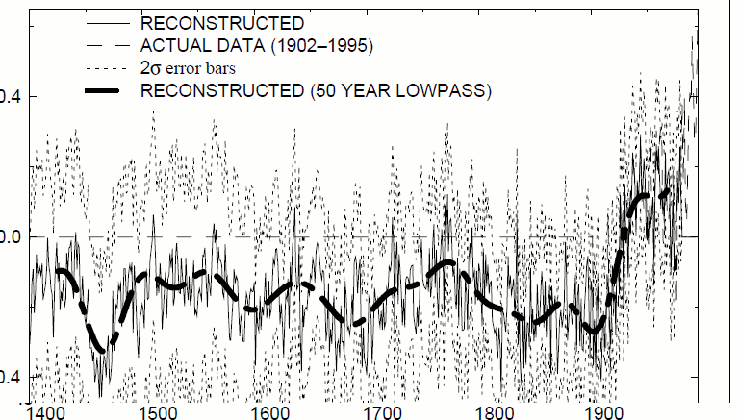
The MBH98 Reconstruction
Above - Mann et al 1998 (Nature) Figure 5b showing temperature reconstruction together with instrumental temperature (dashed

Slide 6
Different Fortunes
Mann to Jones, Sep 17 1998 : I share Phil's concern about getting things "straightened out" before the IPCC report. As one of the lead authors on the "observed climate variation and change" chapter for the 3rd assessment report … 66. 0906042912.txt
Briffa to Bradley, Sep 18, 1998. Also I must write my application to NERC for a fellowship - if this fails Sarah and I are unemployed after December as things stand. God knows there is little chance of success but the application must be in be the end of September and I have not started it yet. This is a big deal for me and I am putting you down as my primary suggested scientific referee. 68. 0906137836.txt
Notes:
The closed-mindedness of these supposed men of science, their willingness to go to any lengths to defend a preconceived message, is surprising even to me. The stink of intellectual corruption is overpowering.
Leaving the realm of epistemic speculation, what many climate scientists do actually say is that the Climategate correspondents were true to their justified conviction about the larger picture, and did not want to confuse the public with their little local difficulty with tree-rings, or whatever. Some are happy to go even further than that, and tell you, on or off the record, that the main thing is to get the public scared enough to act. Exaggerate for the public good. Propaganda becomes the responsible scientist's duty. Whatever it takes, including cooking the books… Still reeling over what is in those emails, I can't say that question interests me much. Once scientists set out to mislead the public, they can no longer expect to be trusted. End of story.

Slide 7
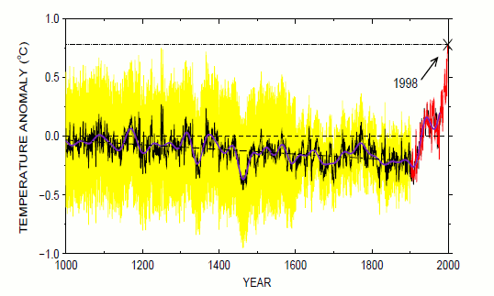
MBH99: the “warmest year”
Above - Mann et al 1999 (GRL) Figure 3.
“startling revelations”
“1990s were the warmest decade of the millennium, with 1998 the warmest year so far””
"even the warmer intervals in the reconstruction pale in comparison with mid-to-late 20th-century temperatures,"

Slide 8
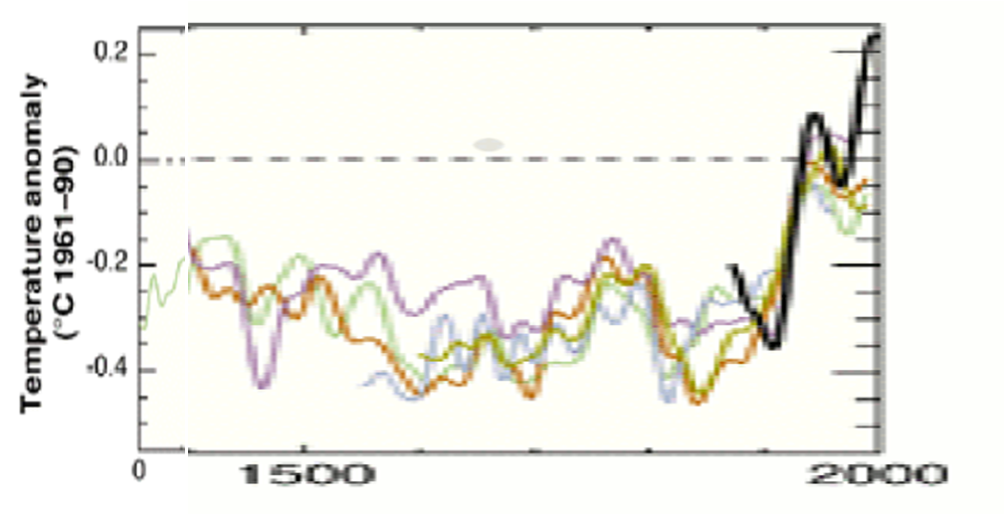
First Bite of the Poison Apple - Briffa and Osborn 1999 (Science)
Above – Excerpt from Briffa and Osborn 1999 (Science ) Figure 1. Briffa reconstruction is in pale blue; post-1960 data is deleted. Mann reconstruction is in purple.

Slide 9
“Better that nothing appear than something unacceptable to us”
Mann to Sciencemag Apr 18, 1999 : "Better that nothing appear, than something unnacceptable to us“ (99. 0924532891.txt)
Bradley to Sciencemag Apr 18, 1999 : I would like to diasassociate myself from Mike Mann's view that "xxxxxxxxxxx" and that they "xxxxxxxxxxxxx". I find this notion quite absurd. …As for thinking that it is "Better that nothing appear, than something unnacceptable to us" .....as though we are the gatekeepers of all that is acceptable in the world of paleoclimatology seems amazingly arrogant. to a Science editor. (99. 0924532891.txt)
Mann to Sciencemag, Bradley, Jnoes, Briffa May 12, 1999:
Thanks all for the hard work and a job well done. I like to think that may feedback helped here--so I take some pride here as well. (111. 0926681134.txt)
Bradley to Briffa and Jones May 12, 1999: Excuse me while I puke. . (111. 0926681134.txt)
Notes:
The closed-mindedness of these supposed men of science, their willingness to go to any lengths to defend a preconceived message, is surprising even to me. The stink of intellectual corruption is overpowering.
Leaving the realm of epistemic speculation, what many climate scientists do actually say is that the Climategate correspondents were true to their justified conviction about the larger picture, and did not want to confuse the public with their little local difficulty with tree-rings, or whatever. Some are happy to go even further than that, and tell you, on or off the record, that the main thing is to get the public scared enough to act. Exaggerate for the public good. Propaganda becomes the responsible scientist's duty. Whatever it takes, including cooking the books… Still reeling over what is in those emails, I can't say that question interests me much. Once scientists set out to mislead the public, they can no longer expect to be trusted. End of story.

Slide 10
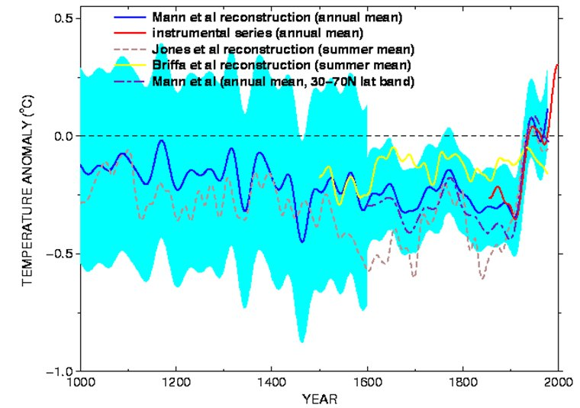
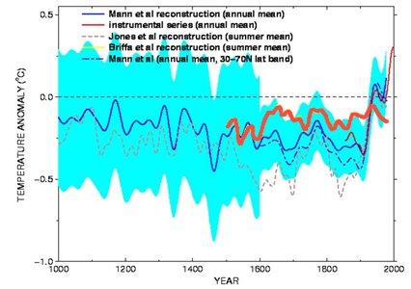
IPCC AR3 Zero Order Draft
Left – Briffa et al 1998 (Nature 393) Figure 1 showing temperature reconstruction; right – Briffa 1998 (Proc Roy Soc London) Figure 6 (in standard deviation units) showing “divergence problem”

Slide 11
The Arusha Post-Mortem (Sep 22, 1999)
#1
Folland: A proxy diagram of temperature change is a clear favourite for the Policy Makers summary. But the current diagram with the tree ring only data [i.e. the Briffa reconstruction] somewhat contradicts the multiproxy curve and dilutes the message rather significantly. [We want the truth. Mike thinks it lies nearer his result … This is probably the most important issue to resolve in Chapter 2 at present. (0938031546.txt)
Mann: everyone in the room at IPCC was in agreement that [Briffa’s series] was a problem and a potential distraction/detraction from the reasonably concensus viewpoint we’d like to show w/ the Jones et al and Mann et al series. (0938018124.txt)
Briffa: I know there is pressure to present a nice tidy story as regards 'apparent unprecedented warming in a thousand years or more in the proxy data' but in reality the situation is not quite so simple… [There are] some unexpected changes in response that do not match the recent warming. I do not think it wise that this issue be ignored in the chapter. (0938031546.txt)
Notes:
The closed-mindedness of these supposed men of science, their willingness to go to any lengths to defend a preconceived message, is surprising even to me. The stink of intellectual corruption is overpowering.
Leaving the realm of epistemic speculation, what many climate scientists do actually say is that the Climategate correspondents were true to their justified conviction about the larger picture, and did not want to confuse the public with their little local difficulty with tree-rings, or whatever. Some are happy to go even further than that, and tell you, on or off the record, that the main thing is to get the public scared enough to act. Exaggerate for the public good. Propaganda becomes the responsible scientist's duty. Whatever it takes, including cooking the books… Still reeling over what is in those emails, I can't say that question interests me much. Once scientists set out to mislead the public, they can no longer expect to be trusted. End of story.

Slide 12
The Arusha Post-Mortem (Sep 22, 1999)
#2
Mann: So, if we show Keith’s series in this plot, we have to comment that “something else” is responsible for the discrepancies in this case. [Perhaps Keith can help us out a bit by explaining the processing that went into the series and the potential factors that might lead to it being "warmer" than the Jones et al and Mann et al series?? We would need to put in a few words in this regard]
Otherwise, the skeptics have an field day casting doubt on our ability to understand the factors that influence these estimates and, thus, can undermine faith in the paleoestimates. I don’t think that doubt is scientifically justified, and I’d hate to be the one to have to give it fodder! (Mann Sep 22, 0938018124.txt)
Notes:
The closed-mindedness of these supposed men of science, their willingness to go to any lengths to defend a preconceived message, is surprising even to me. The stink of intellectual corruption is overpowering.
Leaving the realm of epistemic speculation, what many climate scientists do actually say is that the Climategate correspondents were true to their justified conviction about the larger picture, and did not want to confuse the public with their little local difficulty with tree-rings, or whatever. Some are happy to go even further than that, and tell you, on or off the record, that the main thing is to get the public scared enough to act. Exaggerate for the public good. Propaganda becomes the responsible scientist's duty. Whatever it takes, including cooking the books… Still reeling over what is in those emails, I can't say that question interests me much. Once scientists set out to mislead the public, they can no longer expect to be trusted. End of story.

Slide 13
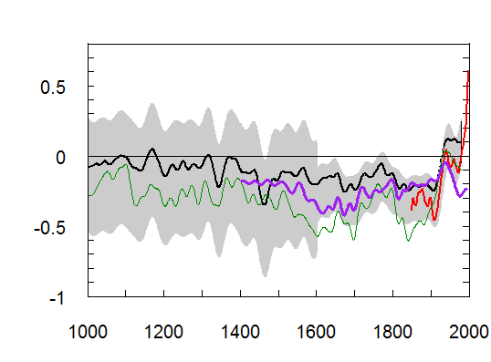
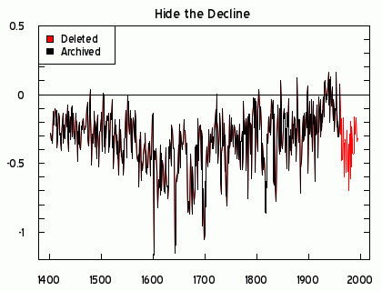
IPCC AR3 First Reviewer Draft
(Oct 27, 1999)
Left- data in Climategate letter of Oct 5, 1999; right – IPCC AR3 First Review Draft Figure 2.24. Briffa reconstruction in green. Post-1960 values have been deleted.
Right – emulation of IPCC AR4 Fig 2-21 without trick.

Slide 14
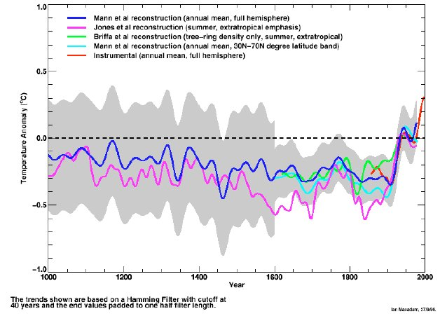
IPCC AR3 First Reviewer Draft
(Oct 27, 1999)
Above – IPCC AR3 First Review Draft Figure 2.24. Briffa reconstruction in green. Post-1960 values have been deleted.

Slide 15
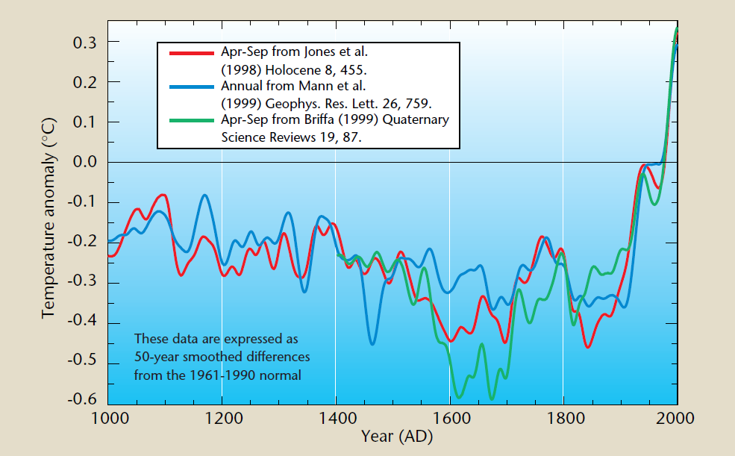
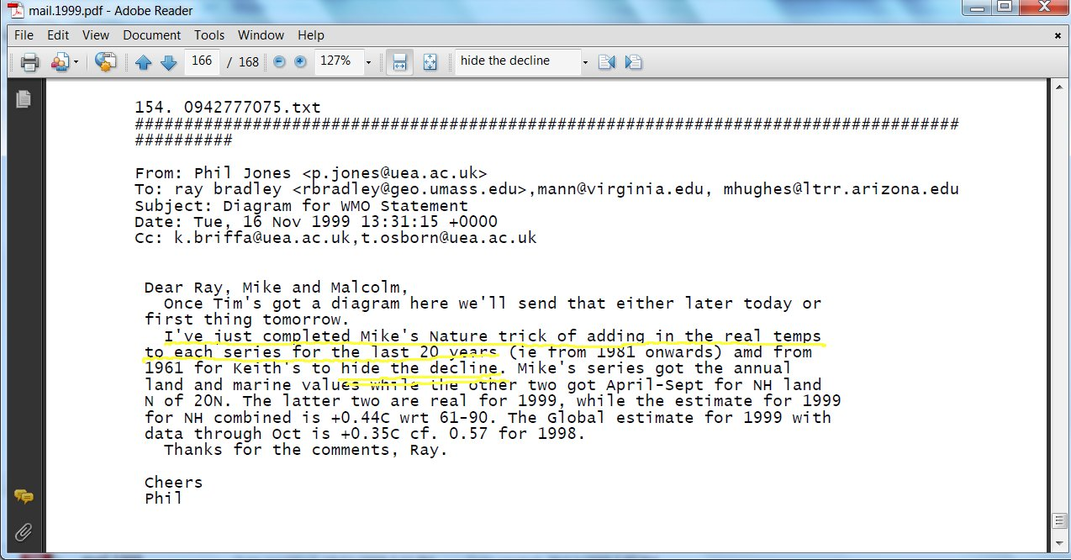
IPCC AR3 First Reviewer Draft
(Oct 27, 1999)
Left- trick email, Nov 15,1999 (154. 0942777075.txt); right – From WMO 1999 Report. Briffa reconstruction i(green) merges proxy data to1960 and instrumental data thereafter.

Slide 16
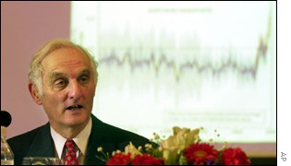
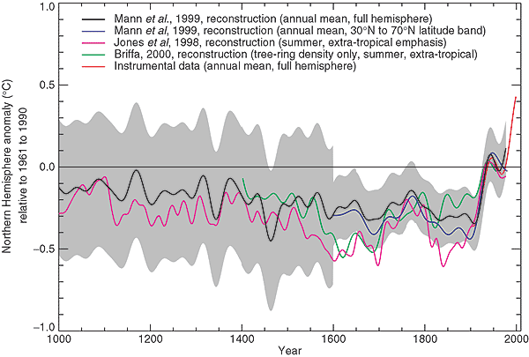
“The Warmest Year, The Warmest Decade”
Top left – hockey sticks in IPCC AR3; top right – John Houghton at IPCC WD1 press conference, Jan 2001; bottom right - IPCC AR3 Figure 2.21, a spaghetti graph consisting of Mann, Jones and Briffa reconstructions. Briffa reconstruction is deleted after 1960, giving a false rhetorical impression of late 20th century consistency.

Slide 17
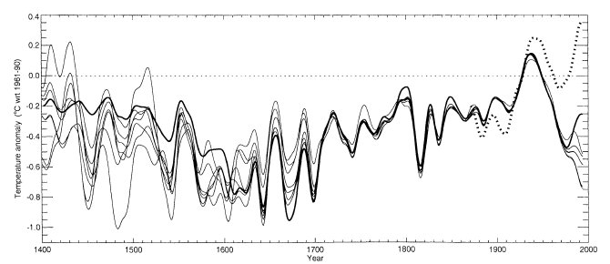
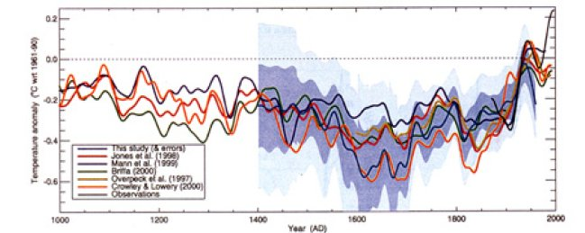
Briffa et al 2001
Left – Briffa et al 2001 Figure 4; right- Briffa et al 2001 Plate 3 – with post-1960 values deleted

Slide 18
“You Can’t Be Serious…
Briffa et al 2001 (JGR): In the absence of a substantiated explanation for the decline, we make the assumption that it is likely to be a response to some kind of recent anthropogenic forcing. On the basis of this assumption, the pre-twentieth century part of the reconstructions can be considered to be free from similar events and thus accurately represent past temperature variability.
Hughes, July 1999. The recent marked weakening in the correlation between tree growth and temperature means that past climate reconstructions are even more reliable than previously thought, said Malcolm Hughes. …
“The recent weaker correlation between tree growth and temperature clearly affects the reliability of our reconstructions of the past. Actually, it means past climate reconstructions (before the 1960s) are better than we thought they were. And, as a result of this, it means that we underestimated the differences between the present century and past centuries,” Hughes said. (http://www.sciencedaily.com/releases/1999/07/990707181851.htm
Notes:
The closed-mindedness of these supposed men of science, their willingness to go to any lengths to defend a preconceived message, is surprising even to me. The stink of intellectual corruption is overpowering.
Leaving the realm of epistemic speculation, what many climate scientists do actually say is that the Climategate correspondents were true to their justified conviction about the larger picture, and did not want to confuse the public with their little local difficulty with tree-rings, or whatever. Some are happy to go even further than that, and tell you, on or off the record, that the main thing is to get the public scared enough to act. Exaggerate for the public good. Propaganda becomes the responsible scientist's duty. Whatever it takes, including cooking the books… Still reeling over what is in those emails, I can't say that question interests me much. Once scientists set out to mislead the public, they can no longer expect to be trusted. End of story.

Slide 19
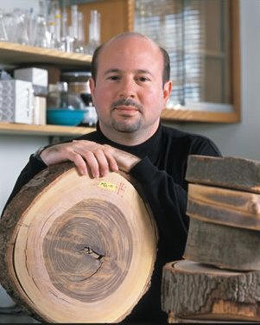
Apr 2003:“Forgotten the exact location”
Dear Dr. Mann, I have been studying MBH98 and 99. I located datasets for the 13 series used in MBH99 … and was interested in locating similar information on the 112 proxies referred to in MBH98 … Thank you for your attention. Yours truly, Stephen McIntyre, Toronto, Canada
Dear Mr. McIntyre, These data are available on an anonymous ftp site we have set up. I've forgotten the exact location, but I've asked my Colleague Dr. Scott Rutherford if he can provide you with that information. best regards, Mike Mann
Steve, The proxies aren't actually all in one ftp site (at least not to my knowledge). I can get them together if you give me a few days. Do you want the raw 300+ proxies or the 112 that were used in the MBH98 reconstruction? Scott

Slide 20
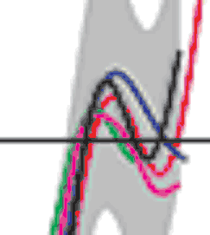
Spotting the Trick
May 1, 2005
Post-1960 values of the Briffa MXD series are deleted from the IPCC TAR multiproxy spaghetti graph. These values trend downward in the original citation (Briffa [2000], see Figure 5), where post-1960 values are shown. The effect of deleting the post-1960 values of the Briffa MXD series is to make the reconstructions more "similar". The truncation is not documented in IPCC TAR. In most cases, people would ask: who at IPCC truncated this series? why did they do so? who approved the truncation? what process was involved in approving the truncation?
Right – blow-up of PCC AR3 Fig 2-21, showing the deletion of Briffa data (green) after 1960.
http://climateaudit.org/2005/05/01/a-strange-truncation-of-the-briffa-mxd-series/

Slide 21
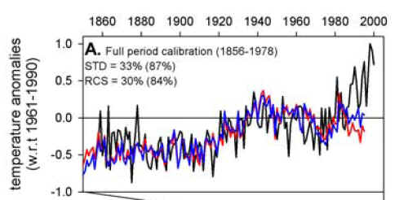
D’Arrigo’s NAS Panel “Splash”
March 1, 2006
“You have to pick cherries if you want to make cherry pie”
“Oh, that’s the Divergence Problem”

Slide 22
“Serious Doubts”
Overpeck March 8, 2006: I'm hearing about D'Arrigo's splash from other sources (Richard Alley) - hope Keith et al., have good counter arguments. 669. 1141930111.txt
Alley, March 8, 2006. if the NRC committee comes out as being strongly negative on the hockey stick owing to RD'A's talk, then the divergence between IPCC and NRC will be a big deal in the future regardless. The NRC committee is accepting comments now (I don't know for how long)... As I noted, my observations of the NRC committee members suggest rather strongly to me that they now have serious doubts about tree-rings as paleothermometers (and I do, too...at least until someone shows me why this divergence problem really doesn't matter) 668. 1141849134.txt
Notes:
The closed-mindedness of these supposed men of science, their willingness to go to any lengths to defend a preconceived message, is surprising even to me. The stink of intellectual corruption is overpowering.
Leaving the realm of epistemic speculation, what many climate scientists do actually say is that the Climategate correspondents were true to their justified conviction about the larger picture, and did not want to confuse the public with their little local difficulty with tree-rings, or whatever. Some are happy to go even further than that, and tell you, on or off the record, that the main thing is to get the public scared enough to act. Exaggerate for the public good. Propaganda becomes the responsible scientist's duty. Whatever it takes, including cooking the books… Still reeling over what is in those emails, I can't say that question interests me much. Once scientists set out to mislead the public, they can no longer expect to be trusted. End of story.

Slide 23
Briffa: “Very Busy with Teaching”
Briffa to NAS Panel, March 15, 2006. the issue [the Divergence Problem] needs more work, this is only an opinion, and until there is peer-reviewed and published evidence as to the degree of methodological uncertainty , it is not appropriate to criticize this [D’Arrigo’s] or other work . For my part, I have been very busy, lately with teaching and IPCC commitments, but we will do some work on this now, though again lack of funds to support a research assistant do not help.
It was my call not to "overplay" the importance of the divergence issue, knowing the subtlety of the issues, in the forthcoming IPCC Chapter 6 draft… This and the divergence problem are not well defined, sufficiently studied, or quantified to be worthy of too much concern at this point…
678. 1143661010.txt

Slide 24
“Not Surprisingly, but Somewhat Alarmingly”
Cook, March 15, 2006 to NAS Panel: Perhaps not surprisingly, but also somewhat alarmingly, it is my understanding that some NRC committee members and other influential participants have come to the conclusion that the observed 20th century "divergence" calls into serious question the value of the tree-ring reconstructions of temperatures over the past millennium. The implicit assumption apparently being made is that the "divergence" being caused by environmental conditions in the 20th century could have also prevailed back during times like the Medieval Warm Period (MWP) some 800-1000 years in the past. If this were the case, then the concern raised by some at the workshop would be justified.…
The lack of any known cause is unfortunate, but this would be true regardless of how the importance of "divergence" is interpreted. I am not aware of ANY evidence that demonstrates the occurrence of large-scale "divergence" between tree growth and climate prior to the 20th century. Indeed, the available evidence indicates just the opposite. .. In my opinion it is therefore unjustified to call into question the use of tree rings for reconstructing temperatures over the past millennium based on a naive and inappropriate extrapolation of the growth "divergence" problem into the past when it appears to be unique to the 20th century. The NRC committee members must consider this in their report if it is to have the necessary scientific credibility that is expected of it.
675. 1142469228.txt
Notes:
The closed-mindedness of these supposed men of science, their willingness to go to any lengths to defend a preconceived message, is surprising even to me. The stink of intellectual corruption is overpowering.
Leaving the realm of epistemic speculation, what many climate scientists do actually say is that the Climategate correspondents were true to their justified conviction about the larger picture, and did not want to confuse the public with their little local difficulty with tree-rings, or whatever. Some are happy to go even further than that, and tell you, on or off the record, that the main thing is to get the public scared enough to act. Exaggerate for the public good. Propaganda becomes the responsible scientist's duty. Whatever it takes, including cooking the books… Still reeling over what is in those emails, I can't say that question interests me much. Once scientists set out to mislead the public, they can no longer expect to be trusted. End of story.

Slide 25
NAS Panel: “Reduced Confidence”
The observed discrepancy between some tree ring variables that are thought to be sensitive to temperature and the temperature changes observed in the late 20th century (Jacoby and D’Arrigo 1995, Briffa et al. 1998) reduces confidence that the correlation between these proxies and temperature has been consistent over time. Future work is needed to understand the cause of this “divergence,” which for now is considered unique to the 20th century and to areas north of 55°N (Cook et al. 2004).

Slide 26

NAS Panel “just kind of winged it …”
At a Texas A&M seminar, North said that they “didn’t do any research”, that they just “took a look at papers”, they got 12 “people around the table” and “we just kind of winged it. That’s what you do in that kind of expert panel.”
http://www.climateaudit.org/?p=812
http://www.met.tamu.edu/people/faculty/dessler/NorthH264.mp4 minute 55 or so
Notes:
http://www.climateaudit.org/?p=809

Slide 27
IPCC AR4 Second Draft Review Comments, June 2006
Reviewer Comment 309-18
Show the Briffa et al reconstruction through to its end; don’t stop in 1960. Then comment and deal with the “divergence problem” if you need to. Don’t cover up the divergence by truncating this graphic. This was done in IPCC TAR; this was misleading. (Reviewer’s comment ID #: 309-18)]

Slide 28
IPCC AR4: this would imply a similar limit on the potential to reconstruct possible warm periods in earlier times at such sites
Several analyses of ring width and ring density chronologies, with otherwise well established sensitivity to temperature, have shown that they do not emulate the general warming trend evident in instrumental temperature records over recent decades, although they do track the warming that occurred during the early part of the 20th century and they continue to maintain a good correlation with observed temperatures over the full instrumental period at the interannual time scale (Briffa et al., 2004; D’Arrigo, 2006). This ‘divergence’ is apparently restricted to some northern, high latitude regions, but it is certainly not ubiquitous even there. In their large-scale reconstructions based on tree ring density data, Briffa et al. (2001) specifically excluded the post-1960 data in their calibration against instrumental records, to avoid biasing the estimation of the earlier reconstructions (hence they are not shown in Figure 6.10), implicitly assuming that the ‘divergence’ was a uniquely recent phenomenon, as has also been argued by Cook et al. (2004a). Others, however, argue for a breakdown in the assumed linear tree growth response to continued warming, invoking a possible threshold exceedance beyond which moisture stress now limits further growth (D’Arrigo et al., 2004). If true, this would imply a similar limit on the potential to reconstruct possible warm periods in earlier times at such sites. At this time there is no consensus on these issues (for further references see NRC, 2006) and the possibility of investigating them further is restricted by the lack of recent tree ring data at most of the sites from which tree ring data discussed in this chapter were acquired.

Slide 29
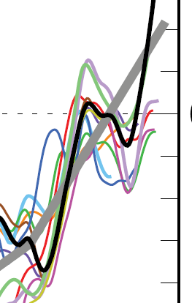
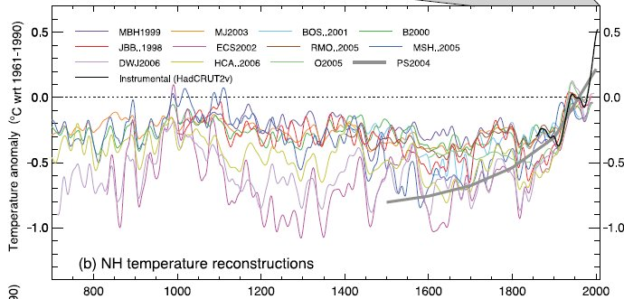
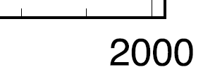
IPCC AR4 Spaghetti Graph
May 2007
IPCC AR4 Figure 6.10b with blow-up. Briffa reconstruction in light blue ends in 1960.

Slide 30
IPCC: “Inappropriate” to show decline
Reviewer Comment 309-18
Show the Briffa et al reconstruction through to its end; don’t stop in 1960. Then comment and deal with the “divergence problem” if you need to. Don’t cover up the divergence by truncating this graphic. This was done in IPCC TAR; this was misleading. (Reviewer’s comment ID #: 309-18)]
IPCC Response
Rejected — though note divergence’ issue will be discussed, still considered inappropriate to show recent section of Briffa et al. series.

Slide 31
UK Met Office Stonewalling
For my own part, I [Mitchell] have not kept any working papers. There is no requirement to do so, given the extensive documentation already available from IPCC. (Feb 2008)
Any records and correspondence had already been deleted and the information is not held by the Met Office. (Ju/ne 2, 2008)
I incorrectly stated that the Met Office held the information you seek and I apologise for this. Dr Mitchell acted as Reviewer of Chapter V1 of the Working Group 1 report in a personal capacity and not on behalf of the Met Office which means that none of the information actually falls within the scope of the Act...The information I sent to you was from Dr Mitchell’s personal records which I was unaware of at the time. There is no requirement under the legislation to search back up data and as stated above, this information is personal to Dr Mitchell. (June 23, 2008)
This information is withheld in accordance with the following exemptions pursuant to FOIA: section 27(1)(b) FOIA – information likely to prejudice relations between the United Kingdom and any international organisation; … (July 22, 2008)
The Met Office has liaised with the IPCC Secretariat and has been instructed that the Met Office is not to allow any emails to be released without discussion with and agreement from ALL participants concerned. The Met Office has learned that the majority of IPCC participants have stated categorically that they believed and still believe that these emails and correspondence are private and confidential because they were not, and were not meant to be, processed in accordance with the formal IPCC process.(Aug 19, 2008)

Slide 32
“Delete Any Emails”
Jones to Mann, May 29, 2008: Mike, Can you delete any emails you may have had with Keith re AR4? Keith will do likewise. …Can you also email Gene and get him to do the same? I don’t have his new email address. We will be getting Caspar to do likewise. …Cheers Phil 891. 1212063122.txt
Mann to Jones, May 29, 2008: Hi Phil, … I’ll contact Gene about this ASAP. His new email is: xxx@xxx. talk to you later, mike 891. 1212063122.txt
Jones to Palmer, May 28, 2008: … Keith (or you Dave) could say that for (1) Keith didn’t get any additional comments in the drafts other than those supplied by IPCC. On (2) Keith should say that he didn’t get any papers through the IPCC process.either. I was doing a different chapter from Keith and I didn’t get any. What we did get were papers sent to us directly – so not through IPCC, asking us to refer to them in the IPCC chapters. If only Holland knew how the process really worked!! Every faculty member in ENV and all the post docs and most PhDs do, but seemingly not Holland. So the answers to both (1) and (2) should be directed to IPCC, but Keith should say that he didn’t get anything extra that wasn’t in the IPCC comments. 888. 1212009215.txt

Slide 33
Realclimate; “people working constructively”…” A good way to deal with a problem”
People working constructively to improve joint publications; scientists who are friendly and agree on many of the big picture issues, disagreeing at times about details and engaging in ‘robust’ discussions; Scientists expressing frustration at the misrepresentation of their work in politicized arenas and complaining when media reports get it wrong; Scientists resenting the time they have to take out of their research to deal with over-hyped nonsense. None of this should be shocking…
Scientists often use the term “trick” to refer to a “a good way to deal with a problem”, rather than something that is “secret”, and so there is nothing problematic in this at all. As for the ‘decline’, it is well known that Keith Briffa’s maximum latewood tree ring density proxy diverges from the temperature records after 1960 (this is more commonly known as the “divergence problem”–see e.g. the recent discussion in this paper) and has been discussed in the literature since Briffa et al in Nature in 1998 (Nature, 391, 678-682). Those authors have always recommend not using the post 1960 part of their reconstruction, and so while ‘hiding’ is probably a poor choice of words (since it is ‘hidden’ in plain sight), not using the data in the plot is completely appropriate, as is further research to understand why this happens.

Slide 34
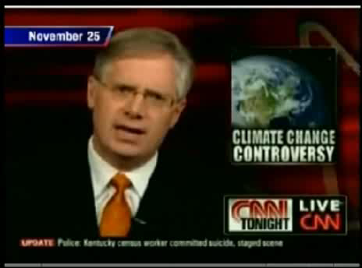

Slide 35
Penn State Inquiry
[Inquiry, Jan 2010: The trick] is explained as a discussion among Dr. Jones and others including Dr. Mann about how best to put together a graph for a World Meteorological Organization (WMO) report. They were not falsifying data; they were trying to construct an understandable graph for those who were not experts in the field. The so-called “trick” was nothing more than a statistical method used to bring two or more different kinds of data sets together in a legitimate fashion by a technique that has been reviewed by a broad array of peers in the field. … there is no basis for further examination of this allegation in the context of an investigation in the second phase of RA-10.
Mann, realclimate, Dec 2004: No researchers in this field have ever, to our knowledge, “grafted the thermometer record onto” any reconstruction. It is somewhat disappointing to find this specious claim (which we usually find originating from industry-funded climate disinformation websites) appearing in this forum.

Slide 36
Quentin Letts, Daily Mail, March 2010
Jones was accompanied by his university’s vice-chancellor, Professor Edward Acton, who provided much-needed comic relief. Professor Acton, a younger version of Professor Calculus from the Tintin books, beamed and nodded at everything Professor Jones said. ‘I think that answer was spot-on,’ he cried, after listening to one response from the terror-stricken Jones.
Professor Acton’s left eyebrow started doing a little jiggle of its own. His eyeballs bulged with admiration for the climate-change supremo. His lips were pulled so wide in wonderment they must nearly have split down the seams like banana skins.
Others, watching the tremulous Professor Jones, will have been less impressed. He may be right about man-made climate change. But you do rather hope that politicians sought second, third, even 20th opinions before swallowing his theories and trying to change the world’s industrial output.
http://www.dailymail.co.uk/news/article-1254763/Lord-Lawson-labelled-climate-alarmists.html
Notes:
The closed-mindedness of these supposed men of science, their willingness to go to any lengths to defend a preconceived message, is surprising even to me. The stink of intellectual corruption is overpowering.
Leaving the realm of epistemic speculation, what many climate scientists do actually say is that the Climategate correspondents were true to their justified conviction about the larger picture, and did not want to confuse the public with their little local difficulty with tree-rings, or whatever. Some are happy to go even further than that, and tell you, on or off the record, that the main thing is to get the public scared enough to act. Exaggerate for the public good. Propaganda becomes the responsible scientist's duty. Whatever it takes, including cooking the books… Still reeling over what is in those emails, I can't say that question interests me much. Once scientists set out to mislead the public, they can no longer expect to be trusted. End of story.

Slide 37
UK Parliamentary Inquiry
7. Critics of CRU have suggested that Professor Jones’s use of the word “trick” is
evidence that he was part of a conspiracy to hide evidence that did not fit his view that recent global warming is predominately caused by human activity. The balance of evidence patently fails to support this view. It appears to be a colloquialism for a “neat” method of handling data. (Paragraph 60)
8. Critics of CRU have suggested that Professor Jones’s use of the words “hide the decline” is evidence that he was part of a conspiracy to hide evidence that did not fit his view that recent global warming is predominantly caused by human activity. That he has published papers—including a paper in Nature—dealing with this aspect of the science clearly refutes this allegation. In our view, it was shorthand for the practice of discarding data known to be erroneous. We expect that this is a matter the Scientific Appraisal Panel will address. (Paragraph 66)

Slide 38
Oxburgh “Science Appraisal” Panel: “Regrettable” but no fault
Recent public discussion of climate change and summaries and popularizations of the work of CRU and others often contain oversimplifications that omit serious discussion of uncertainties emphasized by the original authors. CRU publications repeatedly emphasize the discrepancy between instrumental and tree-based proxy reconstructions of temperature during the late 20th century, but presentations of this work by the IPCC and others have sometimes neglected to highlight this issue. While we find this regrettable, we could find no such fault with the peer-reviewed papers we examined.

Slide 39
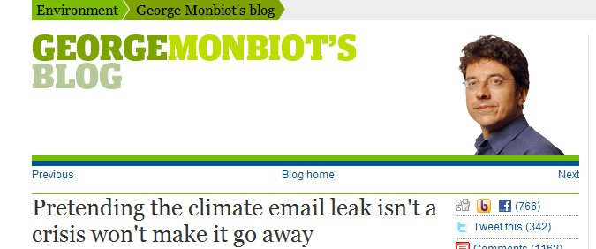
Climategate:
George Monbiot
It’s no use pretending that this isn’t a major blow. The emails extracted by a hacker from the climatic research unit at the University of East Anglia could scarcely be more damaging. I am now convinced that they are genuine, and I’m dismayed and deeply shaken by them. .. … there are some messages that require no spin to make them look bad. (Nov. 23)
I have seldom felt so alone. Confronted with crisis, most of the environmentalists I know have gone into denial. The emails…, they say, are a storm in a tea cup, no big deal, exaggerated out of all recognition. It is true that climate change deniers have made wild claims which the material can't possibly support (the end of global warming, the death of climate science). But it is also true that the emails are very damaging.
The response of the greens and most of the scientists I know is profoundly ironic, as we spend so much of our time confronting other people's denial. Pretending that this isn't a real crisis isn't going to make it go away. Nor is an attempt to justify the emails with technicalities. We'll be able to get past this only by grasping reality, apologising where appropriate and demonstrating that it cannot happen again. (Nov 25)
Notes:
The closed-mindedness of these supposed men of science, their willingness to go to any lengths to defend a preconceived message, is surprising even to me. The stink of intellectual corruption is overpowering.
Leaving the realm of epistemic speculation, what many climate scientists do actually say is that the Climategate correspondents were true to their justified conviction about the larger picture, and did not want to confuse the public with their little local difficulty with tree-rings, or whatever. Some are happy to go even further than that, and tell you, on or off the record, that the main thing is to get the public scared enough to act. Exaggerate for the public good. Propaganda becomes the responsible scientist's duty. Whatever it takes, including cooking the books… Still reeling over what is in those emails, I can't say that question interests me much. Once scientists set out to mislead the public, they can no longer expect to be trusted. End of story.

Slide 40
Visit www.climateaudit.org for ongoing discussion.

