Slide 1
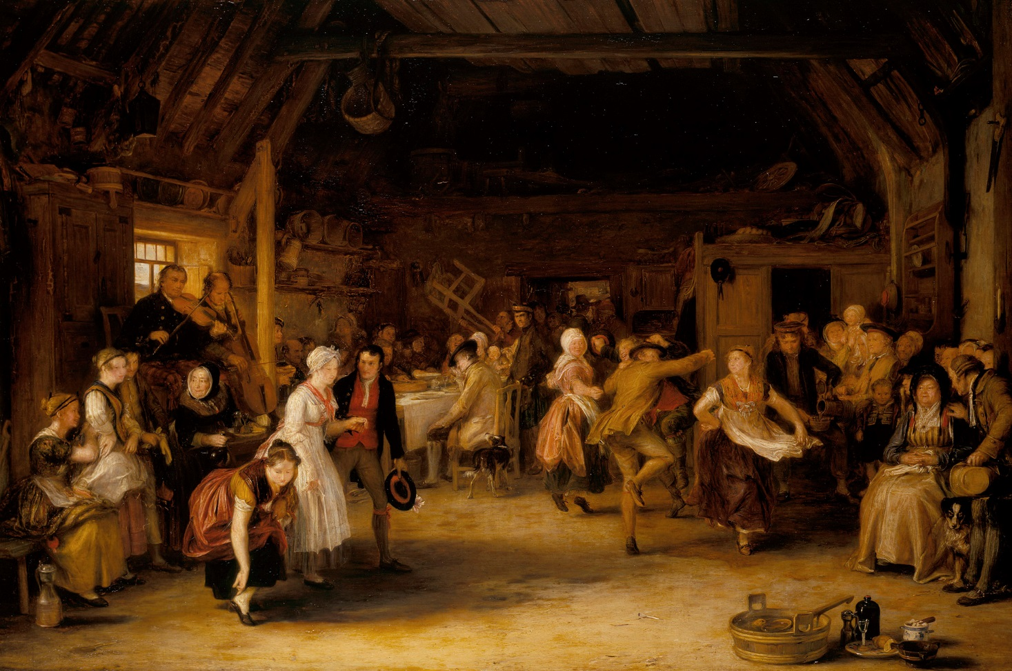
The Penny Wedding:
Alex’ Great-grandfather’s great-grandfather

Slide 2
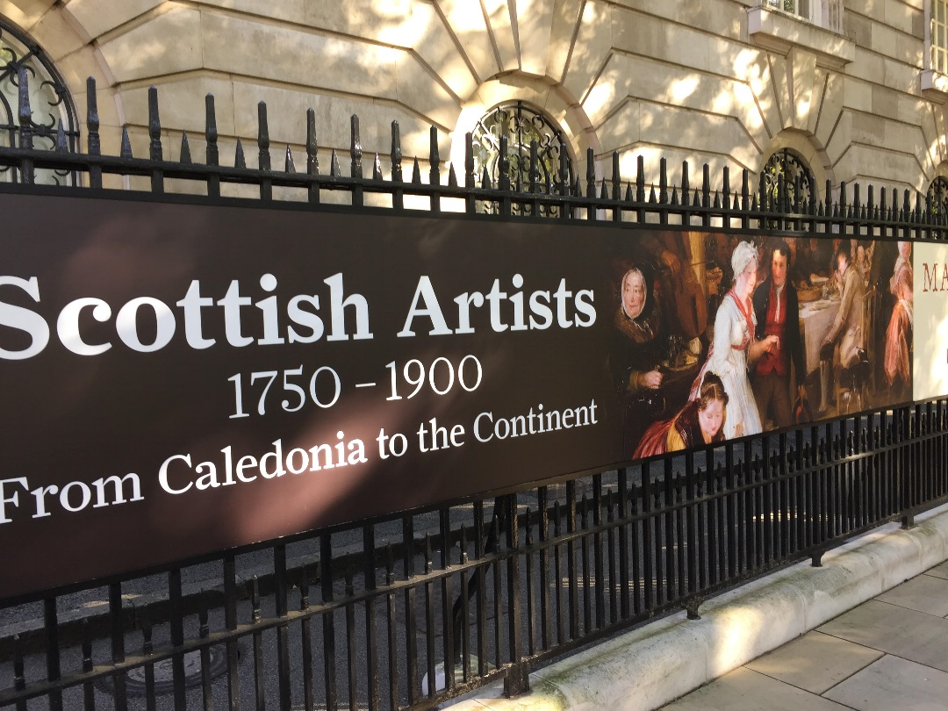
Outside Buckingham Palace

Slide 3
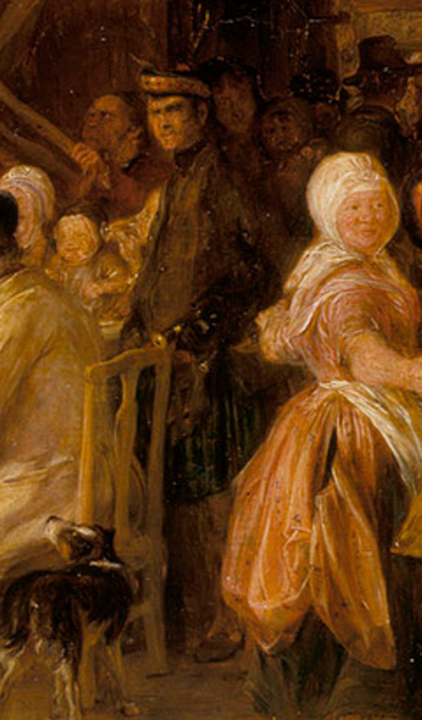
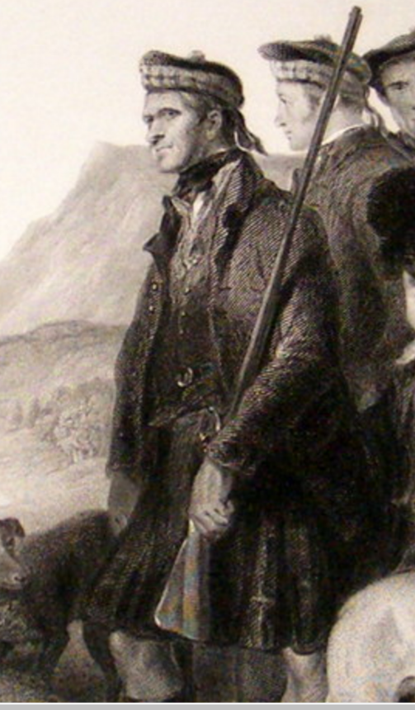
Donald McIntyre

Slide 4
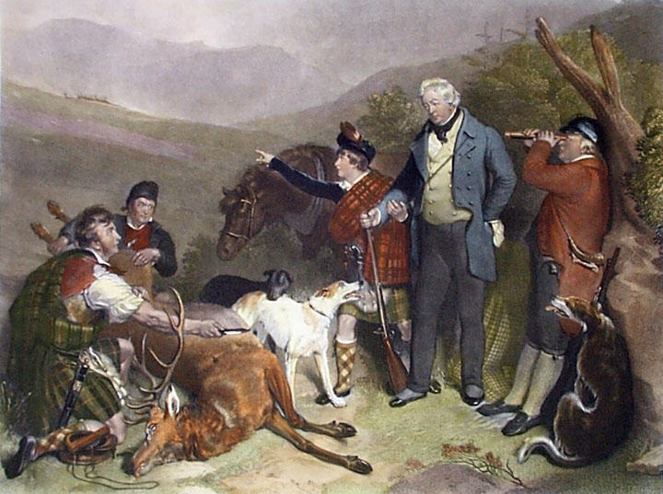
Donald McIntyre and John Crerar, c 1823-33

Slide 5
The Bride

Slide 6
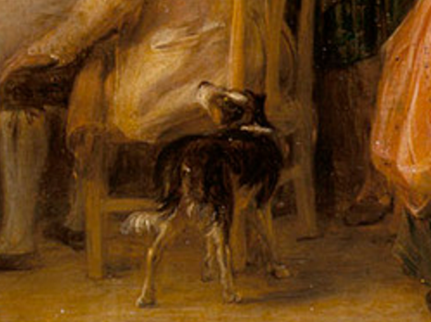
The Dog

Slide 7
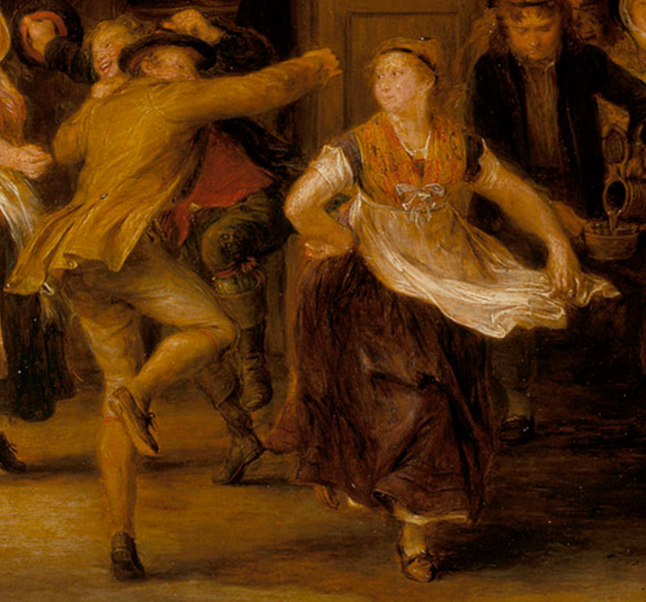
The Father of the Groom

Slide 8
The Disapproving Granny

Slide 9
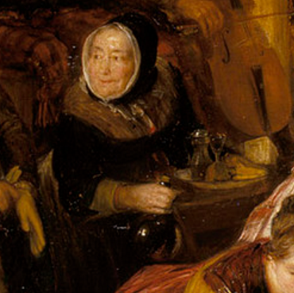
The Granny Straight from the Bottle

